Slide 1
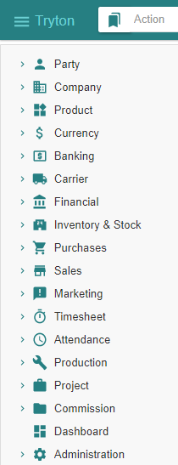
- Getting started - Ancillaries
Tryton By Example
Github - https://github.com/clixwise/tryton-by-example Version of presentation : 6.0 Version of Tryton : 6.0 Verified for execution on : Windows 10 & Powershell 7 Licence : CC BY 4.0 Author : Marc Rottiers

Slide 2
Table of Contents

Slide 3
TOC
Attachment
Note
Managing attachments
Managing notes

Slide 4
Attachment

Slide 5
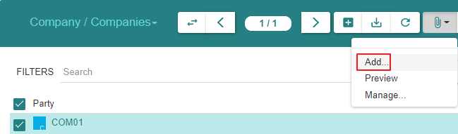
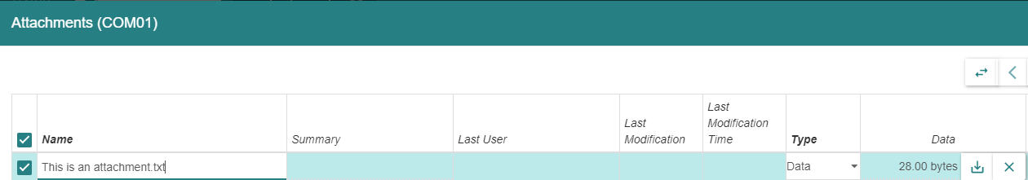
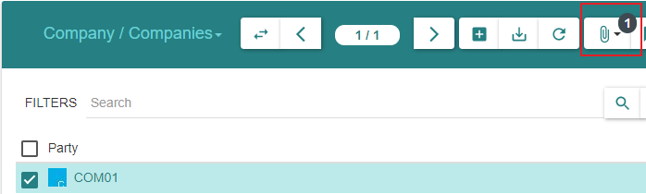
Create

Slide 6
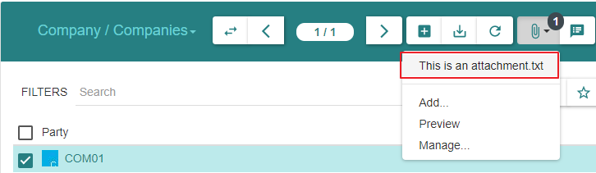
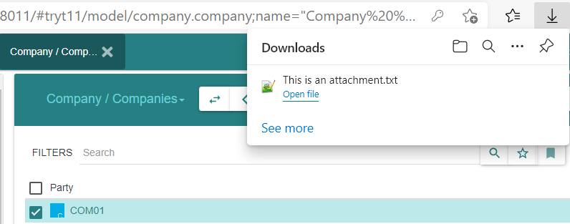
Access

Slide 7
Notes

Slide 8
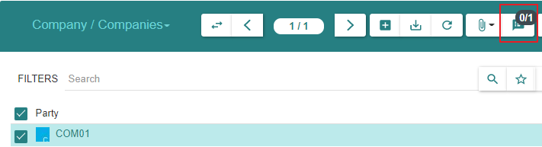
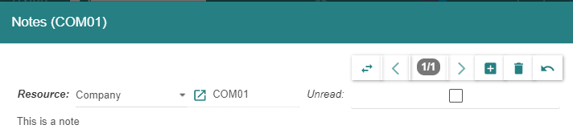
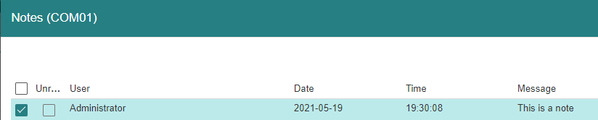
Attaching a « Note »

